Slide 1
Eigenvalues and Eigenvectors
4.5 Complex Eigenvalues
Bumhee Cho

Slide 2
Matrix Eigenvalue-Eigenvector Theory for ℂ^{n}
ℝ^{n}
A complex scalar λ satisfies det (A - λI) = 0
if and only if there is a nonzero vector x in ℂ^{n} such that Ax = λx

Slide 3
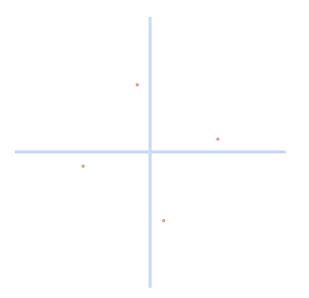
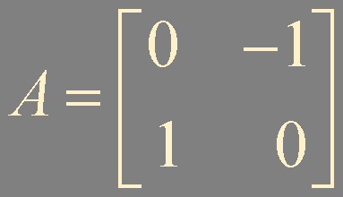
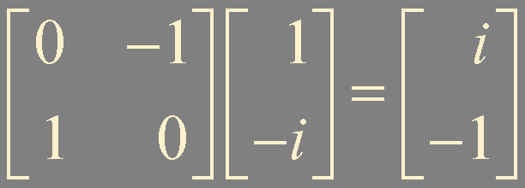
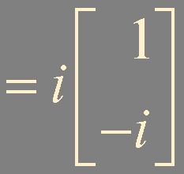
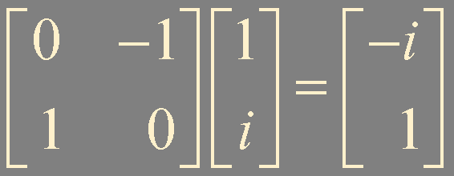
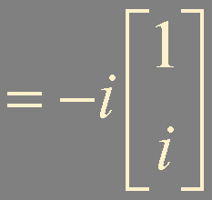
Example 1.
λ² + 1 = 0
λ = i
λ = -i

Slide 4
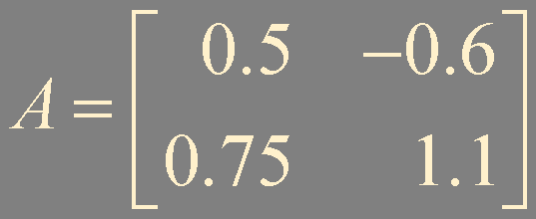





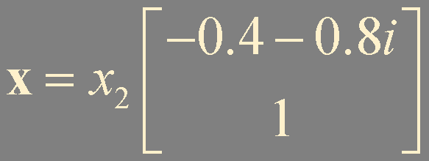
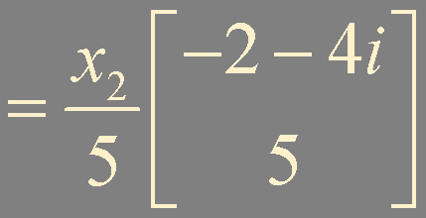

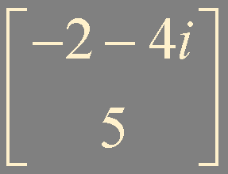
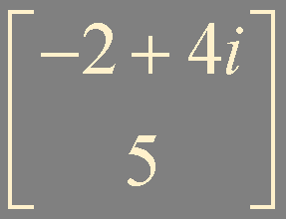

Example 2.

Slide 5
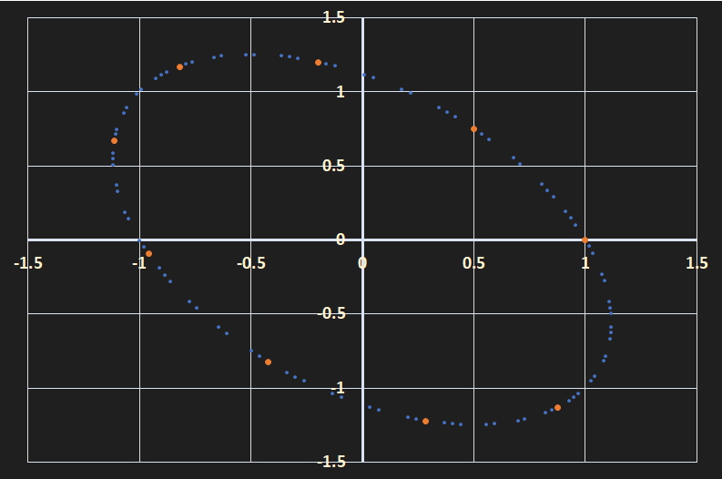
x₀ = (1,0)
x₁ = Ax₀
x₂ = Ax₁
x_{k} = Ax_{k-1}
⋯
x₃
x₂
x₄
x₁
x₀
x₅
x₆
x₇
x₈

Slide 6
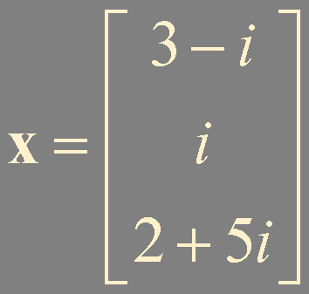
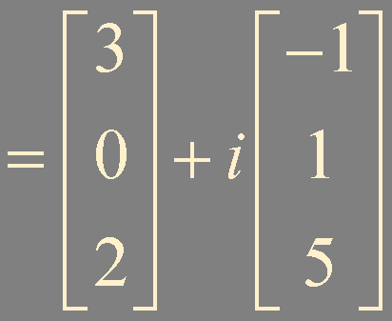
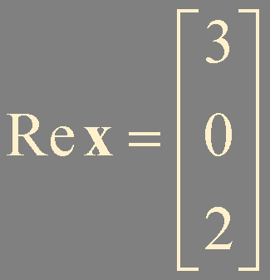
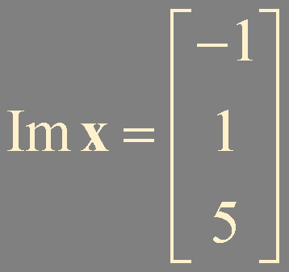
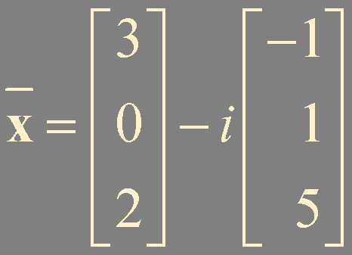


Re x and Im x

Slide 7

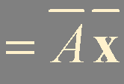




Eigenvalues and Eigenvectors of a Real Matrix That Acts on ℂ^{n}
λ in ℂ^{n}
When A is real,
its complex eigenvalues occur in conjugate pairs

Slide 8
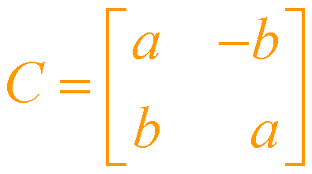



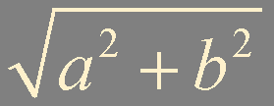

(-b, a)
Cx
(a, b)
φ
b
φ
x
φ
a

Slide 9
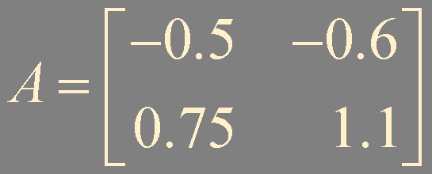
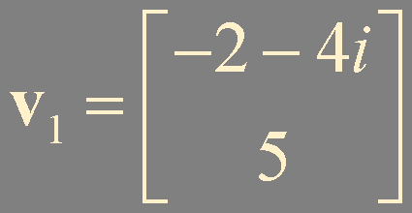

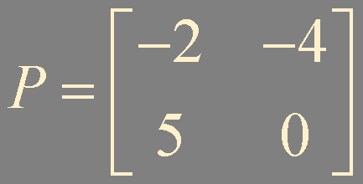



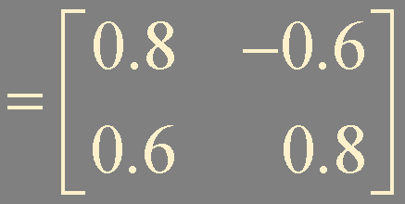

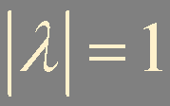

Slide 10
A
x
Ax
P⁻¹
P
u
Cu
C
rotation

Slide 11
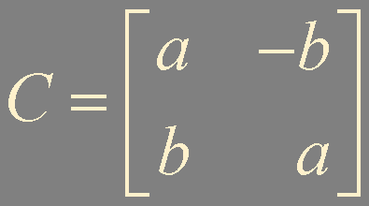











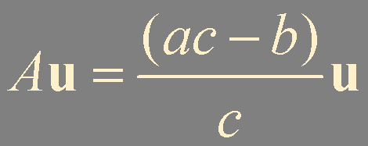
Theorem 8.
Let A be a real 2 × 2 matrix with a complex eigenvalues λ = a - bi (b ≠ 0) and an associated eigenvector v in ℂ^{n},
Re v and Im v are linearly dependent

Slide 12


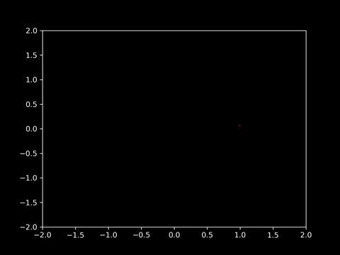
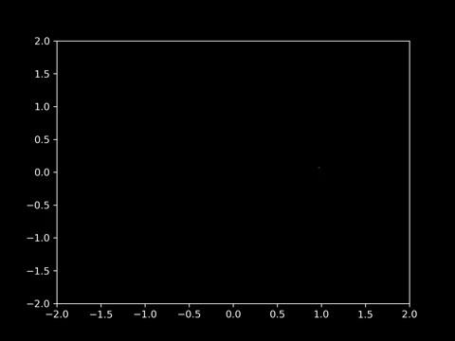

Slide 13
Summary
Complex eigenvalues and eigenvectors
Geometric interpretation

